Slide 1
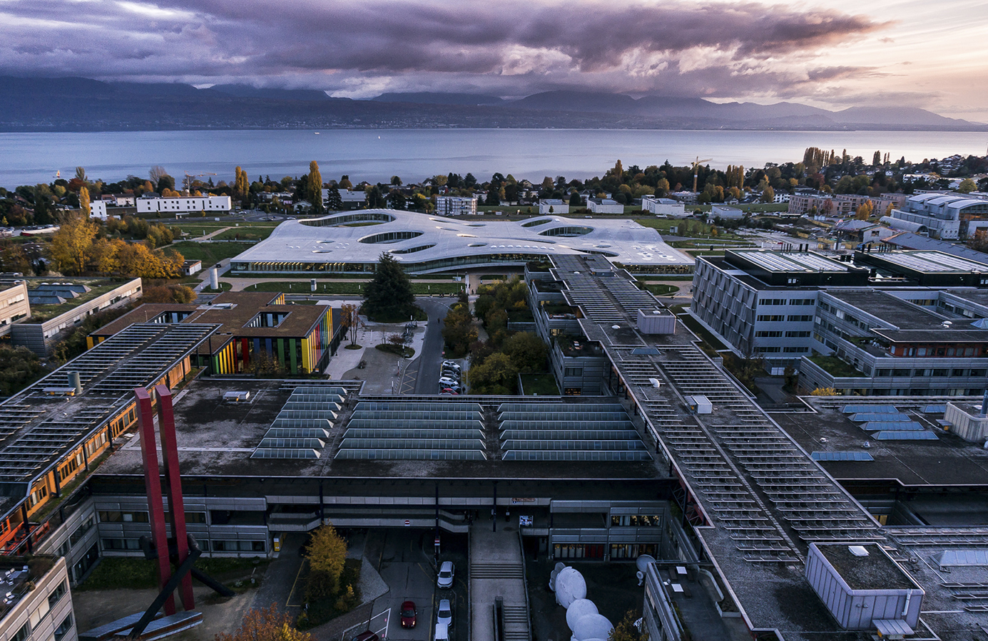
MICRO-722: 3D Printing with light
Paper Presentation-Temporal focusing in 2PP
Buse Ünlü
06.03.2023

Slide 2
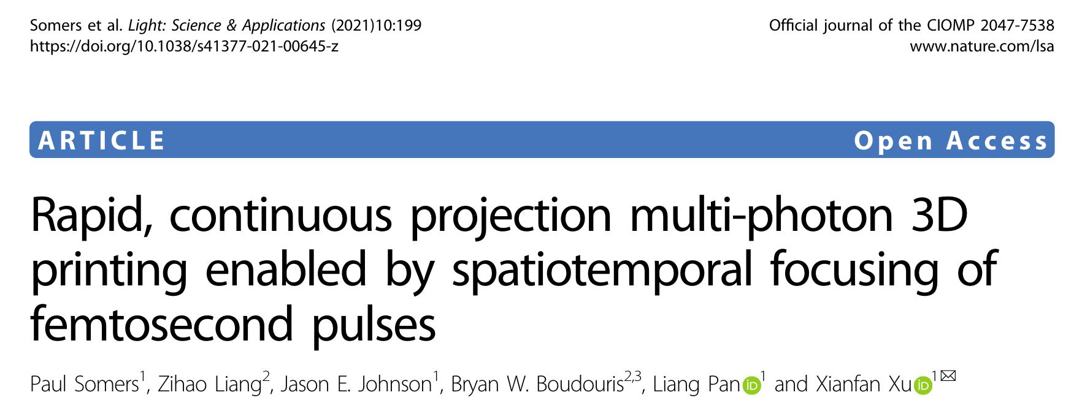
Article
MICRO-722: 3D Printing with light

Slide 3
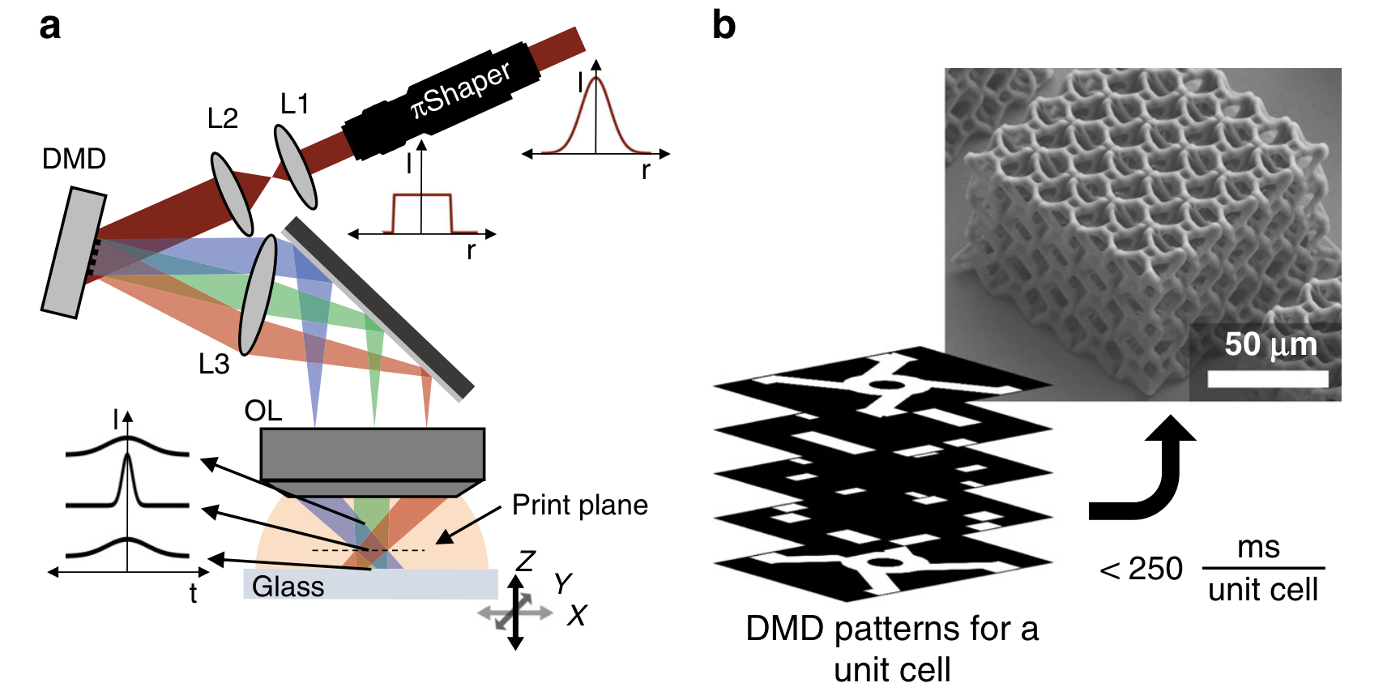

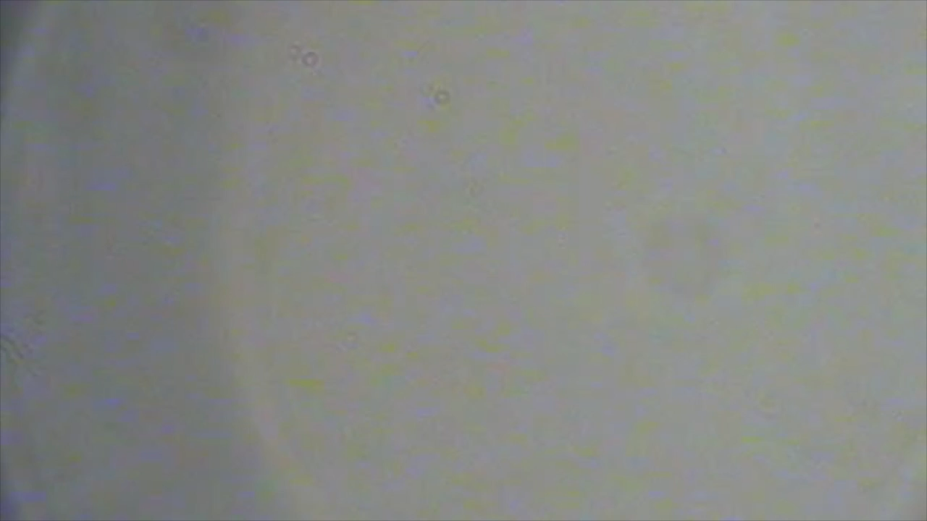
Continuous, layer-by-layer projection two-photon lithography system
-Schematic of spatiotemporal printing system-
800 nm laser
22 nm bandwidth, 5 kHz repetition rate
Adjacently fabricated metamateriallike 3D unit cell
Patterning rates up to 4 kHz
Desired angular dispersion
(separate-colored beams )
100X, NA 1.49
MICRO-722: 3D Printing with light
laser pulse stretched in time
Vertical stage speed of 100 μm s⁻¹

Slide 4
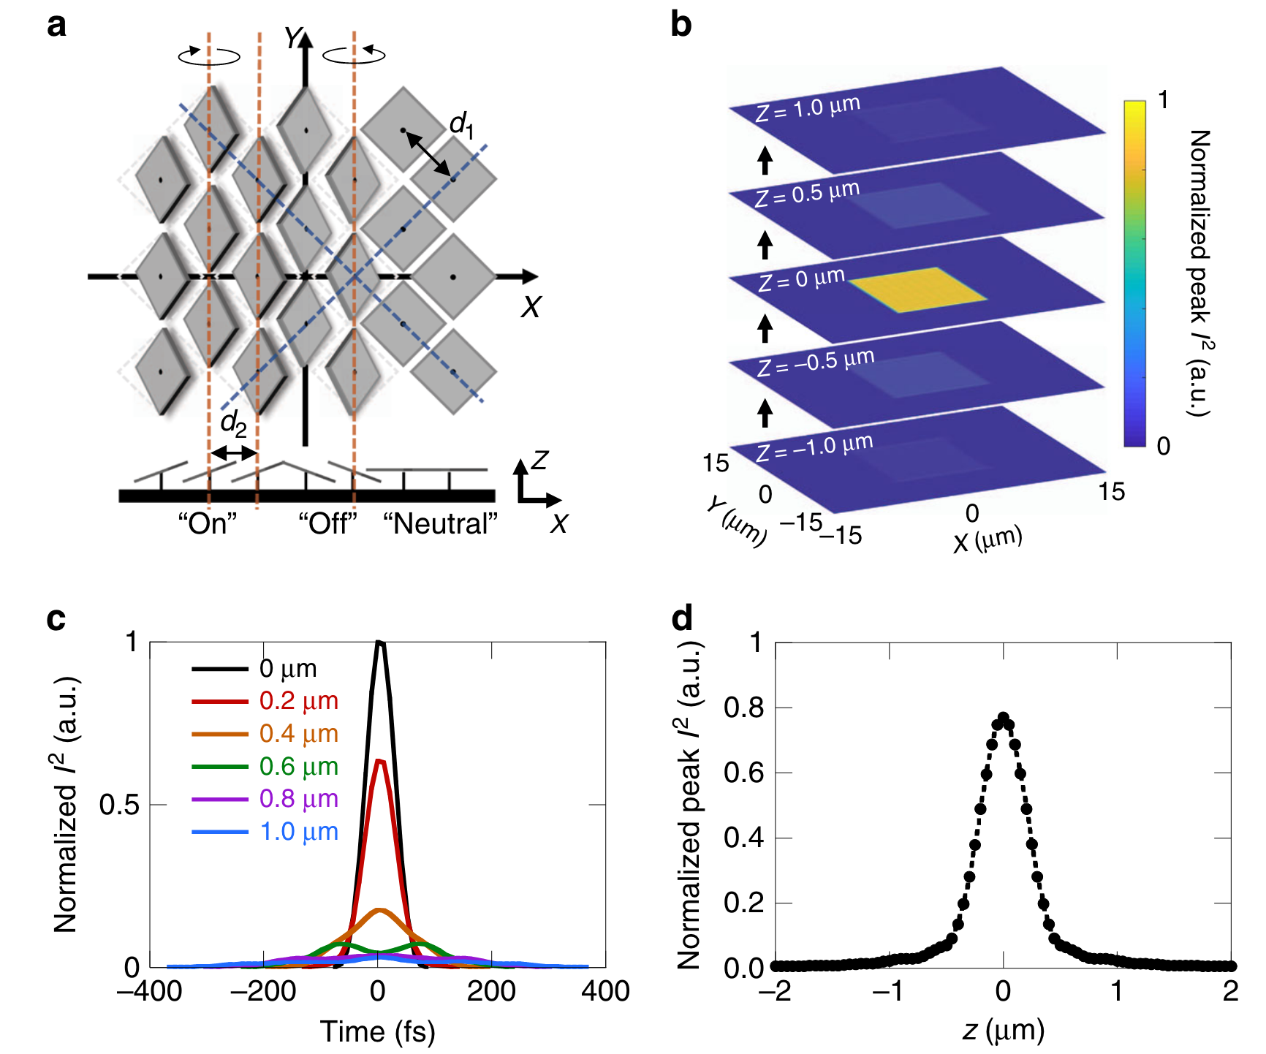
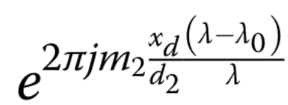
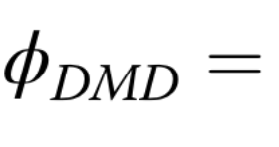
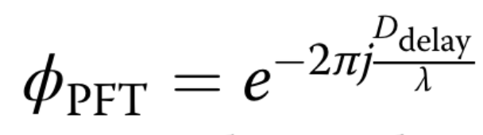
Numerical model for spatiotemporal focusing
- Confining the patterned light sheet to a thin region for controlled print layer thickness
- Monochromatic coherent Fourier optics with paraxial approximations
Phase term used to represent the DMD dispersion (1D grating effect);
-Incident angle of the laser (to achieve a blazed diffraction order)
→ 3.65 fs μm⁻¹ delay across the pulse area
Phase term of pulse front tilt (diffracting off the DMD);
MICRO-722: 3D Printing with light

Slide 5
Numerical model for spatiotemporal focusing
Time domain pulse profile
-1.52×2.28 mm² rectangular pattern
MICRO-722: 3D Printing with light
Print thin 2D planes on the scale of single micrometer thickness

Slide 6
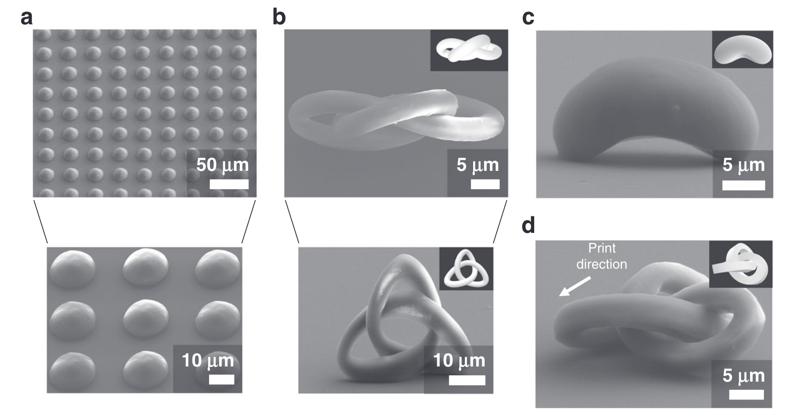
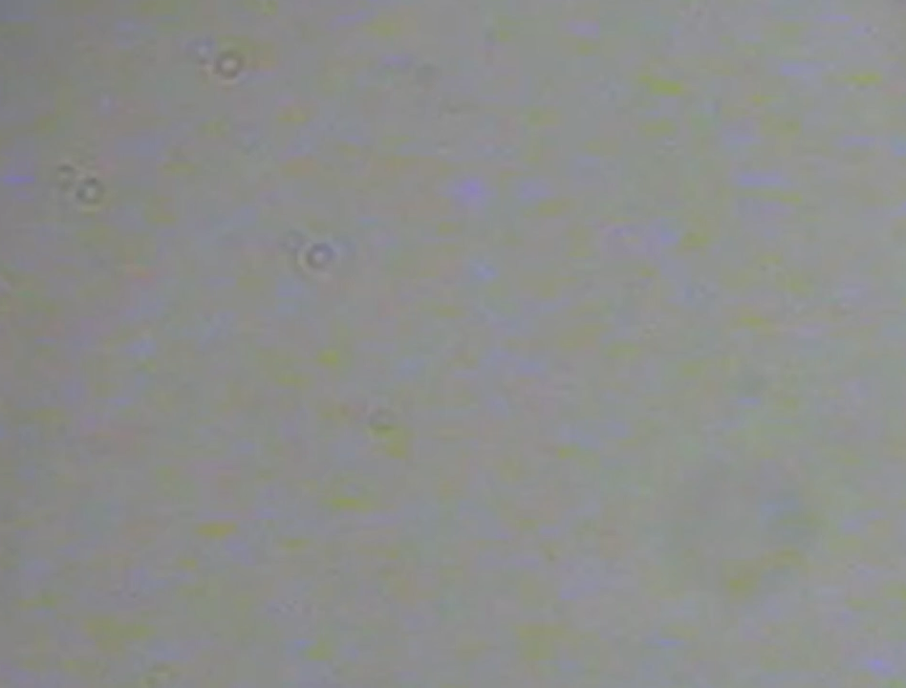
3D Printed Structures
-Using continuous, layer-by-layer projection two-photon lithography system
100 μm s⁻¹ stage speed along the vertical (z) direction, 120-144 W cm⁻² laser intensity.
Hemisphere (< 120 ms)
Complex trefoil knot
Chicago’s Cloud Gate sculpture
1 mm² area in 6.2 min.
Aspherical geometries
MICRO-722: 3D Printing with light
Curved surfaces
within 319 ms
Complex, curved features
Sharper features with a square cross-section

Slide 7
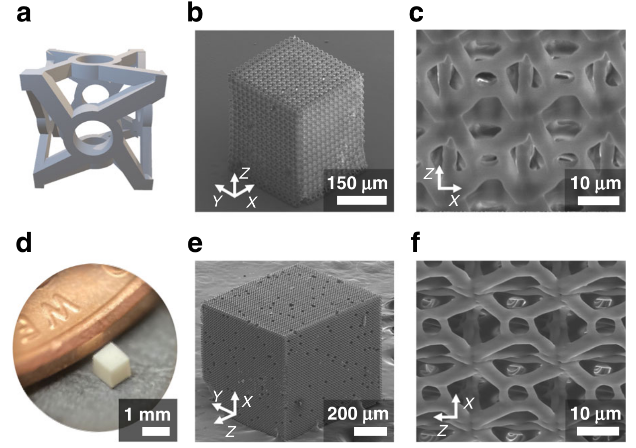

Scalability and large volume printing
Rapid 3D printing of macroscale metamaterial-like structures
15 × 15 × 15 unit
Printing speed: 400 $μ$m s⁻¹
Straight and curved components in all 3 dimensions, close separations along the z direction
Vertical stage speed: 400 μm s⁻¹
Stage translation speed between units: 1 mm s⁻¹
Laser intensity: 216-312 W cm⁻²
42 × 42 × 42 unit
Printing speed: 1 mm s⁻¹
MICRO-722: 3D Printing with light

Slide 8
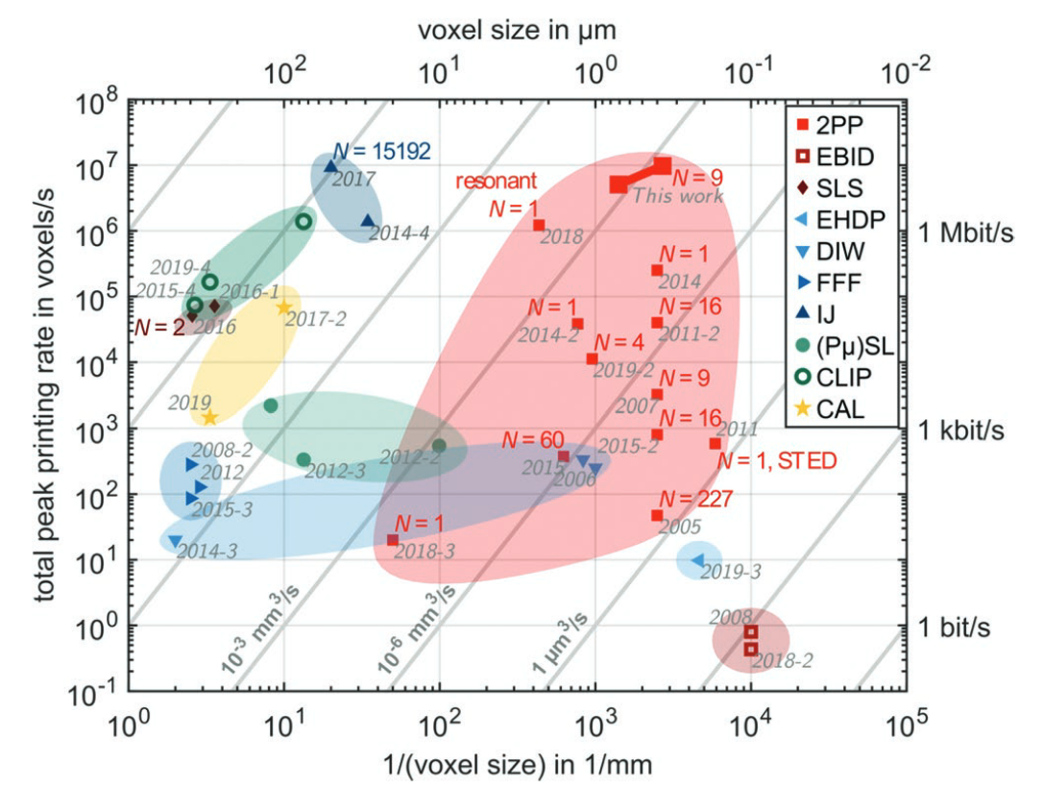
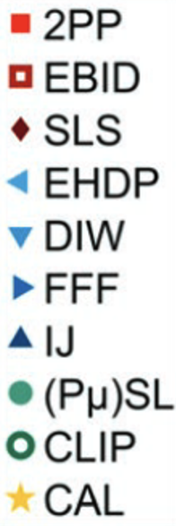
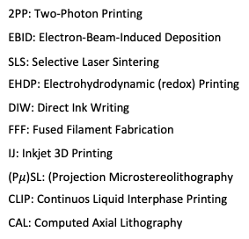
Voxel Printing Rate
Woodpile structure
Vertical stage speed: 1 mm s⁻¹
Pattern exposure time for each layer: 500 µs
Linewidth = 380 nm
Line height = 2470 nm
2PP: Two-Photon Printing
EBID: Electron-Beam-Induced Deposition
SLS: Selective Laser Sintering
EHDP: Electrohydrodynamic (redox) Printing
DIW: Direct Ink Writing
FFF: Fused Filament Fabrication
IJ: Inkjet 3D Printing
(P$μ$)SL: (Projection Microstereolithography
CLIP: Continuos Liquid Interphase Printing
CAL: Computed Axial Lithography
MICRO-722: 3D Printing with light
Voxel print rate
= 3.2 × 10⁶ voxels s⁻¹
1425 nm voxel size
~0.28 µm³
16 × 16-pixel unit on the DMD → printed voxel as a result of the 16 pixel wide patterns in the woodpile
Vincent Hahn et al. Adv. Funct. Mater. 2020, 30, 1907795

Slide 9
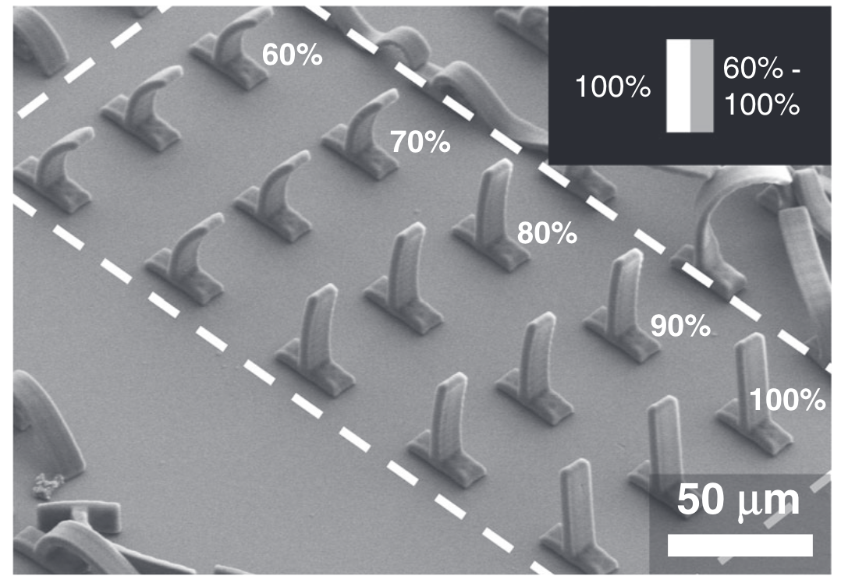
Structuring potential of projection two-photon lithography
Tuning structure characteristics using grayscale projection
Grayscale values
Micropillars
MICRO-722: 3D Printing with light
Lower grayscale values → Less crosslinking of the photoresist → Larger amount of shrinkage
Nonuniform shrinkage → Residual stresses → A curvature of the pillars

Slide 10
Summary & Discussion
A continuous, layer-by-layer projection 2PL system for high-speed fabrication of polymer 3D structures with micron and submicron scale features.
Complex 3D geometries including smooth, curved surfaces - in a continuous fashion on the millisecond timescale
Numerical model
    Dispersion effects from the DMD
    Pulsefront tilt imparted on the laser pulse
Rapid (1.08 × 10⁻³ mm³ s⁻¹) 3D printing of a metamaterial-like structure of millimetre-scale
    Capable of printing arbitrary 3D structures
MICRO-722: 3D Printing with light

Slide 11


THANK YOU FOR YOUR ATTENTION!
Any Questions?

Slide 12
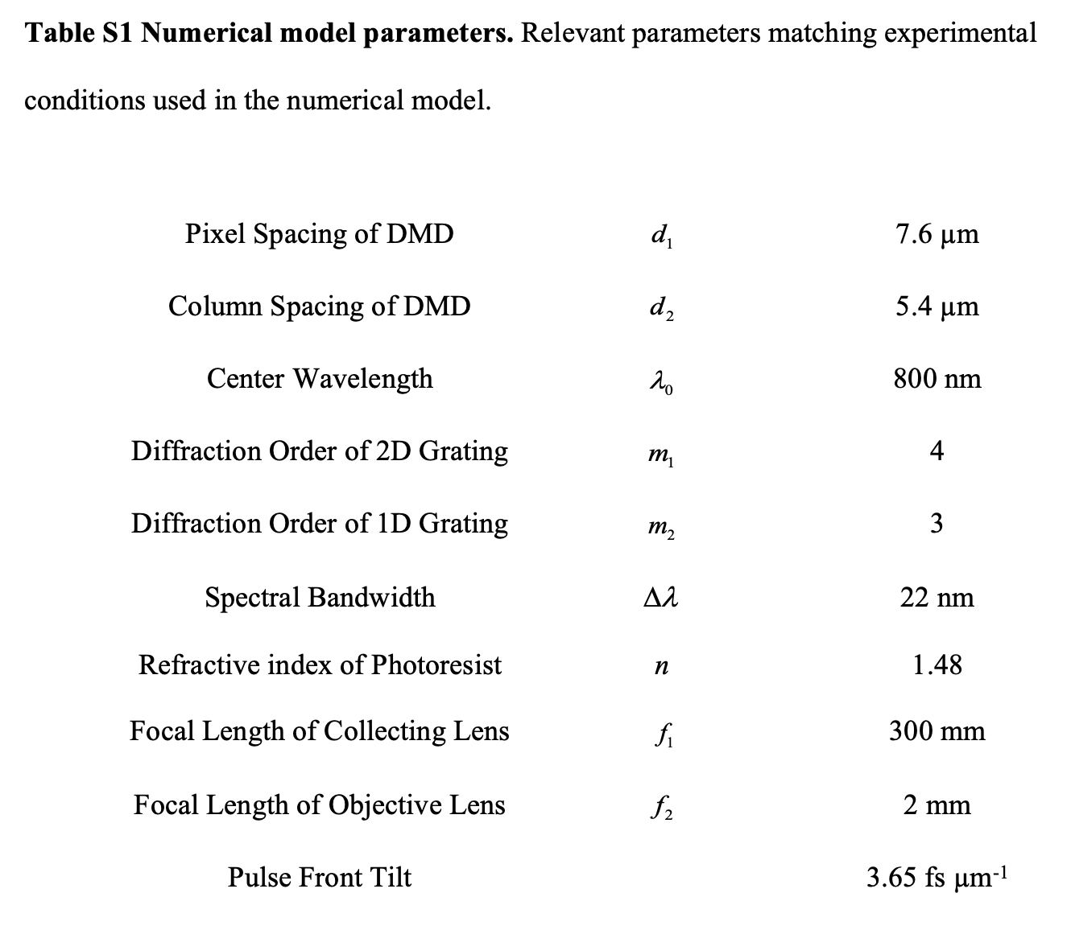
MICRO-722: 3D Printing with light

Slide 13
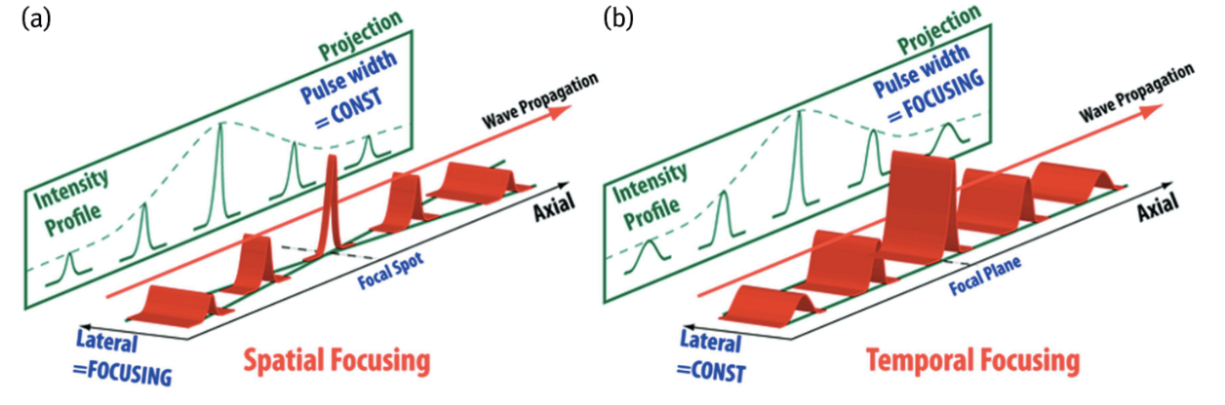
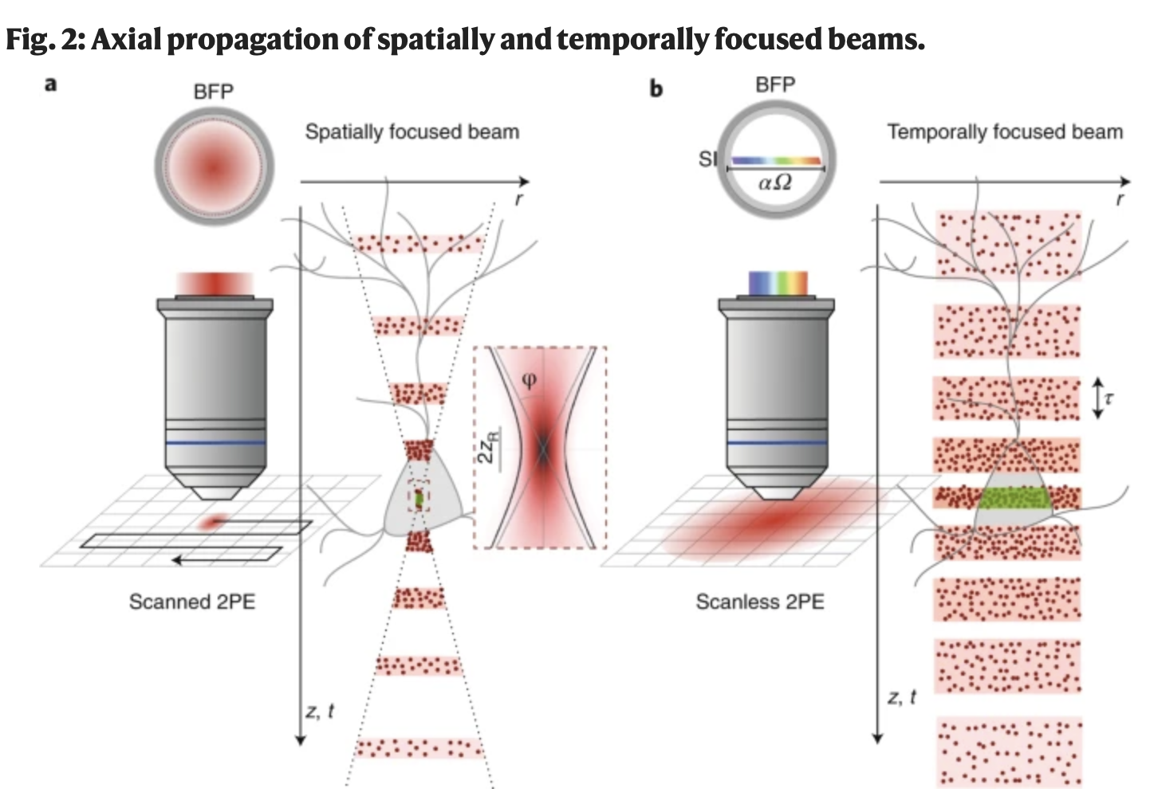
So, Peter T. C. et al. Multiphoton Microscopy and Fluorescence Lifetime Imaging: Applications in Biology and Medicine, edited by Karsten König, Berlin, Boston: De Gruyter, 2018, pp. 103-140.
MICRO-722: 3D Printing with light
Papagiakoumou, E. et al, Nat Methods 17, 571–581 (2020).

